Slide 1
CHEMICAL HAZARDS
AND
PERSONAL PROTECTIVE EQUIPMENTS
Chen-Peng Chen, Ph.D.
Department of Occupational Safety and Health
China Medical University
April 24, 2018
Chung Yuan Christian University

Slide 2
Learning Goals
Understanding chemical hazards present in the laboratory and strategy of prevention and control
  Hazard communication for chemical substances
  Pointers on management of chemical hazards
Understanding different types of personal protective equipments (PPEs) commonly used in the laboratory and workplace
Learning how to properly select, use, maintain, and store PPEs

Slide 3
Characteristics of
Laboratory as a Workplace
Presence of miscellaneous hazardous, harmful, or toxic chemicals in significant quantity
Change in personnel by rotation or entry of new employees at a significant level
Elevated risk of unknown and uncertain nature owing to development of new technique and research
High density of technology and equipment
Notes:
Key points:
The statistics on laboratory accidents revealed that in Taiwan most of the accidents were chemical-related. This was largely due to:
1. Chemicals used in laboratory were, in essence, hazardous, harmful, or toxic (more than 500 different chemicals currently being regulated by government authorities);
2. Due to chemical incompatibility, the improper storage, use, and management of chemical and its liquid waste could lead to accidents;
3. In academic laboratory, the workers (often time the users of chemical) were rotated frequently, including the entry of new employees; human errors were a significant risk factor;
4. Academic research often focused on developing new technologies, prone to occurrence of unknown hazard and risk.
The top five factors in association with laboratory accidents were: hazardous/harmful materials (20.1%), electrical equipments (12.3%), chemical equipments (11.7%), stock materials (6.5%) and others (24.0%).

Slide 4
The Risk Pyramid
Death or Severe Injury
(1 case)
Minor Injury
(29 cases)
False Alarm
(300 cases)
Significance of Unsafe Behavior and Status
Notes:
Key points:
Prevention of major disasters must start with preventing minor accidents!
Importance of practices in laboratory safety and hygiene:
- Knowledge can be gained from experience, however with a high price when it comes to laboratory safety and health;
- Over 90% of safety issues are rooted in human errors that could have been avoided or prevented;
- These errors occurred not as a result of poor knowledge, but because of inadequate use of knowledge or use in an ineffective manner.

Slide 5
Outlines
Section 1: Chemical Hazards and Strategy of Evaluation and Control
Section 2: Pointers on Management of Chemical Hazards
Section 3: Overview of Personal Protective Equipments and Eye/Facial Protection
Section 4: Respirators
Section 5: Protective Clothing and Hand Protection

Slide 6
Section 1
Chemical Hazards and
Strategy of Evaluation and Control

Slide 7
Definition of Hazard
Hazard: any sources of potential damage, harm or adverse health effects on something or someone under certain conditions
  A hazard can cause harm or adverse effects to individuals as health effects, or to organizations as property or equipment losses
  There are five major categories of hazard present in the workplace: chemical, physical, biological, ergonomic and safety hazards
Notes:
Key points:
There are five major sources of hazard present in the workplace:
Chemical hazards referring to harms and effects associated with specific chemical substances;
Physical hazards referring to various forms of excess energy or forces;
Biological hazards associated with contact with organisms/microorganisms or their derivatives (by-products, metabolites, and etc);
Ergonomic hazards referring to factors related to the design of task, work area or tools;
Safety hazards potentially leading to serious injury or death or causing property damage.

Slide 8

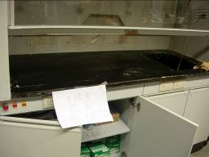
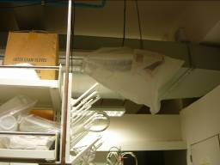
Chemical Hazards
Toxicity: harmful effect such as poisoning or tissue ulceration due to contact or uptake of chemical by route of inhalation, ingestion, or skin contact
Hazard: the damage caused by chemical due to energy released from chemical reaction, such as fires and explosions
Notes:
8

Slide 9
Classification of Airborne Hazards
“Particulates” are particles
capable of suspending in the air,
with a size typically ranging from micro- to nano-meter
Liquid
Grease
Mist
Dust
Fume
Bioaerosol
Particulate Contaminants
Gaseous Contaminants
Gas
Vapor
Gas
Solid
Notes:
Key points:
The airborne contaminants represent a major presence of chemical hazards in the laboratory and workplace from the perspectives of chemical exposure prevention and control. The airborne hazards can be in the form of solid, liquid, or gas/vapor. They may come in different size, shape, and physical state, and thus require different strategies in protective measures.

Slide 10
Classification of Airborne Hazards
The airborne hazards can be in the form of solid, liquid, or gas/vapor:
  Dusts are solid particles suspending in the air; they can be originating from cutting, grinding, or drilling of solid material, and in general are of a size greater than 5 µm
    Examples include lead dusts present in battery-manufacturing facilities
  Fumes are solid particles made of metals suspending in the air due to heating and subsequent condensation; in general the particles have a size less than 0.5 µm
    Examples include tin/manganese fumes generated from welding works
Notes:
10

Slide 11
Classification of Airborne Hazards
  A third class of dusts receiving great attention are biological aerosols, such as those of bacteria, viruses, and fungi
    Some bioaerosols are capable of entering the lungs at a great depth when inhaled
  Liquid particulates are generally referred to as mists
    Examples include those formed from droplets of lubricating oil used in metal-cutting work
    If the originating solution is acidic, then the mists are called acidic mists, such as sulfuric acid mists or chromic acid mists; both acid mists are highly corrosive
Notes:
11

Slide 12
Classification of Airborne Hazards
  Gas molecules possess a significant tendency to diffuse, and they evenly occupy the diffused space
    Examples include carbon dioxide, ethene (used in welding), carbon monoxide from combustion, and etc
  Vapor consists of molecules evaporating from liquid or subliming from solid due to heating or provision of energy; these molecules otherwise stay as liquid or solid under normal temperature and pressure
    Examples include organic solvents used in paints or other commonly known solvents such as benzene, n-hexane, carbon tetrachloride, all have been reported in industrial accidents and some confirmed as carcinogens
Notes:
12

Slide 13
Case study: Fire from flammable solvent destroying laboratory
A glass container carrying 4 liters of n-hexane ruptured in a university’s laboratory
The chemical might have evaporated when the graduate student mopped off the spill and subsequently came in contact with the temperature control of a furnace, resulting in a fire
The fire was put off after two and a half hours; three laboratories were directly destroyed, with a loss of approximately 10 million NTD

Slide 14
Hazard Evaluation and Control
Hazard evaluation
  A process to determine type and severity of hazard based on the work/experimental process and the equipment/ material used in the process
  For chemical hazard, the evaluation includes review of chemical’s Safety Data Sheet to understand physicochemical characteristics of the substance in the environment (e.g. solid/liquid/gas or vapor; corrosivity; volatility; and lipophilicity) as well as its toxicity
Notes:
Key points:
Before devising a strategy of exposure control, the occupational professional needs to inspect the work or experimental processes and the equipments and materials used in these processes to determine on the presence of possible hazard(s) and the significance of injury and damage resulting from exposure.
For chemical hazards, the evaluation process includes a review of the chemical’s Safety Data Sheet to facilitate an understanding on the physicochemical attributes of the chemical in the environment (e.g. solid/liquid/gas or vapor; corrosivity; volatility; and lipophilicity), the biological route of uptake (inhalation, digestion, or skin absorption) and the toxicity. Based on these physicochemical characteristics, an industrial hygienist can subsequently determine the chemical’s potential uptake by humans and the resulting toxicity. For example, gaseous and highly volatile chemical may be absorbed primarily by route of inhalation, while nonvolatile chemical will be absorbed primarily via digestion or skin absorption. Thus the contact of the skin with corrosive materials should be avoided at all cost. The information on the level of toxicity can be used to facilitate a decision on the intervention approach and protective mechanism.

Slide 15
Hazard Evaluation and Control
Priority of hazard prevention
  Engineering control
    Substitution: Replacing highly toxic stock material with those of lower toxicity; substituting high-risk experimental process with low-risk one
    Reduction: Experimenting with less stock material
    Isolation: Separating lab workers not directly involved in handling hazard-producing equipment or experimental process from the work zone
    Ventilation: Local exhaust ventilation or general ventilation (dilute ventilation)
Notes:
Key points:
To prevent occupational injury or disease occurring among the workers, all safety/health hazards or risk factors present in the workplace have to be eliminated or adequately controlled. When deciding on the control strategy, always choose those that best control the contaminants at the source.
For different intervention approaches, engineering control is of the highest priority, administrative control the next, and PPEs the least. Keep in mind that PPEs are the last line of defense against exposure to occupational hazards; when they fail the users (i.e. the workers) risk an immediate exposure to the hazardous chemical. Thus, PPEs should only be considered and used after a comprehensive protection program is established and implemented.

Slide 16
Hazard Evaluation and Control
Priority of hazard prevention
  Administrative control
    Education and training; personal hygiene; workplace cleaning and maintenance; material labeling; worker rotation; environmental monitoring; and health surveillance
  PPEs
    These are not an alternative to engineering and administrative controls
    They should be used only as the last line of defense
    Occupational emphasis has been on respirators and chemical protective clothing (including gloves)
16
Notes:
16
Key points:
In most workplace and laboratory settings, chemical hazards should be removed or sufficiently reduced to an acceptable level via implementation of adequate engineering control, administrative strategy, or these methods in combination, and the use of PPEs should not be considered up front when selecting an intervention. However, there are occasions when using PPEs may present the only feasible solution in preventing the workers from being harmed. These occasions include:
- Task of a temporary nature or work of short duration;
- Performance of maintenance, service, and repair of equipment for prevention of workplace hazard;
- When a hazard in the workplace or from the industrial/experimental process can not be adequately controlled by means of engineering/administrative controls;
- When a hazard can not be reduced to an acceptable level after engineering measures are exhausted;
- In the event of emergency response or rescue mission.

Slide 17
Section 2
Pointers on Management of Chemical Hazards

Slide 18
Strategy in Hazard Management
Laboratory personnel should observe the following elements when working in laboratory to facilitate a proper evaluation of potential hazard and take preventive action
  Codes of safe laboratory practice
  Material used in the experiment
  Equipment/apparatus and protocol used in the experiment
Strategies of hazard prevention adopted in different types of laboratories might vary significantly, in the next slides only examples common to most laboratories are provided to illustrate cautions and strategies for hazard prevention
Notes:
Key points:
Know your laboratory, and know your experiment:
- Understanding the environmental conditions associated with the experiment to be conducted in a laboratory, the nature and detail of the work, and the potential hazard(s)
resulting from the experiment is key to prevent occupational injury and harm;
- Make sure the laboratory personnel read the laboratory safety and health guidelines before they start on the experiment;
- Pay attention to the material and equipment used in the experiment, and adopt adequate strategy to prevent hazardous conditions from arising;
- Learn the know-how of emergency response, escape, and first-aid upon event of a laboratory accident.
Codes of safety and health practice in laboratory:
The codes of practice are laboratory-specific, as they are developed in accordance with the nature and the details of the works conducted in the laboratory. Laboratory personnel should be familiar with the contents in these codes and abide by them. The experiments conducted in the laboratory may change over time; consult your laboratory management and make necessary amendments to the codes if they are considered outdated.
18

Slide 19
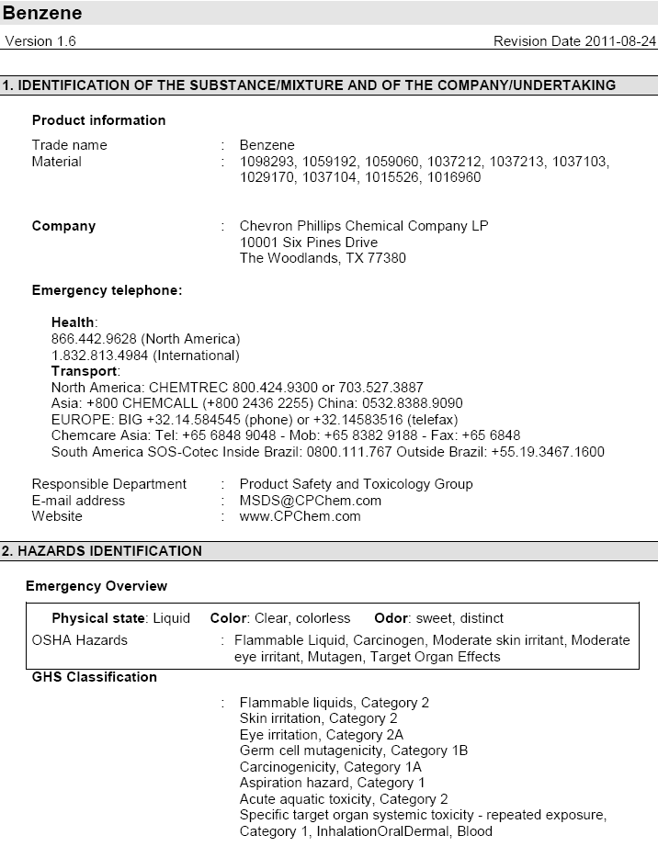
Safety Data Sheet (SDS)
SDS are required for display in laboratory handling chemical, and should be displayed at visible locations of easy access
Contents of SDS in current display should be confirmed for accuracy and updated periodically
  The updated record should be on file for three years
Sections of SDS directly relevant to emergency response: First Aid Measures, Fire-Fighting Measures, Accidental Release Measures, and Exposure Controls/Personal Protection
A SDS for benzene
Example
(Source: Chevron Philips Chem Co; http://www.cpchem.com/msds/100000068511_SDS_
US_EN.PDF)
Notes:
19

Slide 20
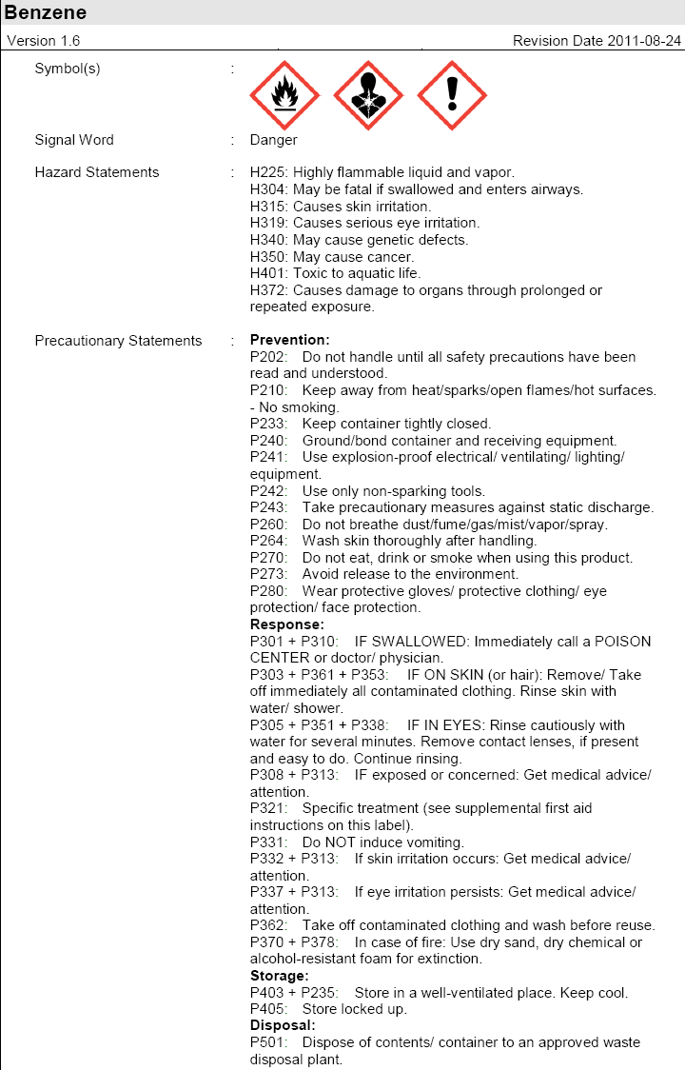
Hazard Communication
—Chemical Labeling
The containers of hazardous material used in laboratory should be labeled with the following information from GHS:
  Hazard symbol
  Contents, including:
    Chemical name
    Signal word (caution)
    Hazard statements (hazard warning message)
    Precautionary statements (prevention, response, storage, and disposal)
Example
A GHS display for benzene containing elements required for labeling
(Source: Chevron Philips Chem Co; http://www.cpchem.com/msds/100000068511_SDS_US_EN.PDF)
Notes:
20

Slide 21
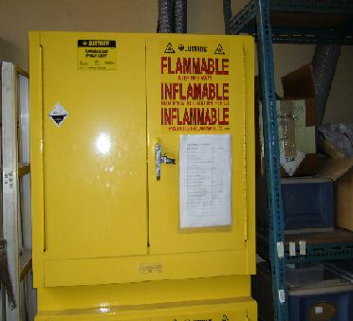
Storage of Chemical
Exhaust ventilation
Hazardous material should be stored in accordance with its properties (e.g., volatility, flammability, and compatibility)
The exhaust ventilation system installed in the storage facility should receive periodic inspection and maintenance
Facilities storing a significant level of volatile, flammable liquid should be installed with flammable gas detectors
Fire and explosion safety cabinet
Notes:
21
Complementary information:
The exhaust ventilation connected to a fire and explosion safety cabinet should be periodically checked and maintained. In addition, when a leakage-alarming device is installed, select the device based on the types and properties of the chemical in storage (e.g., lower explosion limit should be considered in the selection process).

Slide 22
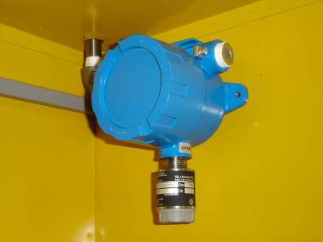
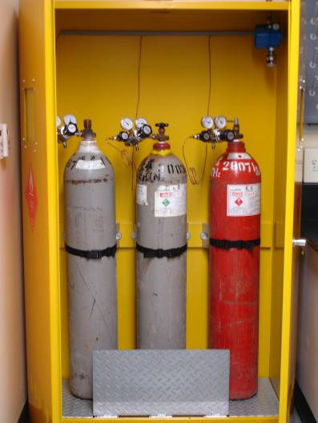
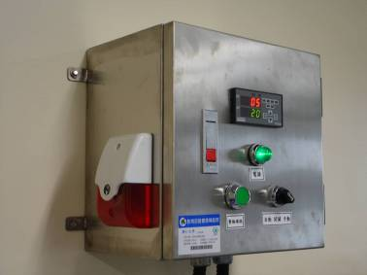
Fire and explosion safety cabinet
for storage of hydrogen cylinders
Hydrogen detector
Alarming device
Notes:
22
Complementary information:
1. The facilities storing flammable and pressurized gas are required to be equipped with leakage detection and alarming device for the chemical in storage;
2. A chemical-specific detector (e.g. hydrogen leakage detector) should be installed if it is only a single chemical being stored;
3. A universal detector (e.g. flammable gas detector) should be used when the storage facility contained multiple non-specific materials such as the facilities for waste liquid storage;
4. The users of a detector should be alert of the potential difference among different detectors when setting up the threshold concentration triggering the alarm for the leakage.

Slide 23
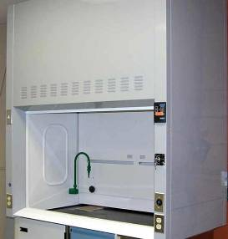
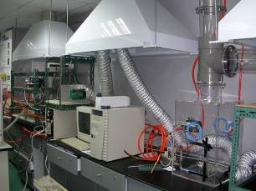
Ventilation Equipments
Volatile chemical should be processed and handled in a ventilation hood
Samples containing microorganisms of airborne capability should be processed and handled in a biosafety cabinet
Ventilation hood for chemical processing and biosafety cabinet for handling micro-organism are different in functions and the ways they function—don’t mix-use them
Do not leave material/tool in the hood unless necessary; they may influence stability of air flow for ventilation
Ventilation hood
Local exhaust ventilation
Notes:
23
Complementary information:
Scientific equipment in the laboratory should be operated and maintained in local exhaust ventilation. For example, the inlet in the injection port of a gas chromatograph under heated conditions may release toxic gas, and thus should be covered in local exhaust ventilation (as displayed in the lower-right picture of this slide).

Slide 24
Ventilation Equipments
If toxic gas may be released from scientific equipment during its operation, the point of gas emission should be covered in local exhaust ventilation
Local exhaust ventilation, ventilation hood, and relevant equipments are required to be annually checked (e.g. for transport velocity)
Stop your experiments immediately when the followings occur and seek help to check/repair:
  Damage in exhaust pipeline
  Abnormal operation of driving motor
  Blocking of filtration device
  Any other signs of abnormality (e.g. irregular sounds)
Notes:
24
Key points:
1. The workers in a laboratory where chemical or biological hazards are present must observe the codes of safety and health practice and always handle the hazardous materials in a ventilation hood, a ventilation cabinet, or in a device equipped with local exhaust ventilation;
2. The devices of local exhaust ventilation such as ventilation hood are required to be inspected every year. However, some schools or laboratories may require a simplified inspection be done at a greater frequency, e.g. monthly or semi-annually. There are also schools that require the simplified inspection be done on a daily basis. The audience should check with their schools and observe the school’s rules.

Slide 25
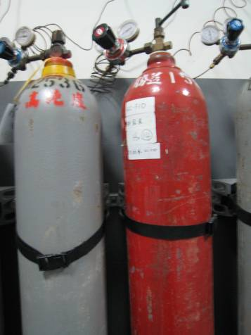
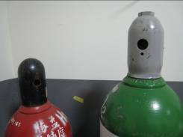
Gas Cylinders
When using a high-pressure gas cylinder, observe the followings:
  Cylinder transversely fixed?
  All gauge pressures normal?
  Inflammable objects present in the cylinder storage room?
  Constituents of gas in cylinder clearly labeled?
  Leakage from connection points?
  Temperature in the storage room over 40ºC?
Do not leave a wrench on cylinder-regulating valve!
Cylinder has to be tightly fixed!
Empty cylinders or those on reserve should be capped
Notes:
25

Slide 26

Use and Management of
Toxic Chemical Substances
Containers and packaging of toxic chemical substances (TCS) should be labeled as required and attached with a copy of SDS
Entrance of facility where chemical is handled should be labeled with the sign “Handling Premises of Toxic Chemicals”
Mechanism preventing release or leakage of TCS should be activated and operated when chemical is processed; emergency response equipment should be made available
Notes:
26
Key points:
The entrance of the facility where toxic chemical substances are handled are required to be labeled with the sign “Handling Premises of Toxic Chemicals.” Note that this labeling is required only for toxic chemical substances, not for non-specific hazardous materials.

Slide 27
Use and Management of
Toxic Chemical Substances
TCS should be stored in airtight, sturdy containers or packaging
  Storage room or storage facility for TCS needs to be locked when the chemical are stored in the room
Emergency response equipments and detecting/alarming devices should be periodically checked and calibrated
The amounts of TCS in storage need to be in consistence with those on record
The record of operation for TCS should remain on file for three years at the location of operation
Notes:
27

Slide 28
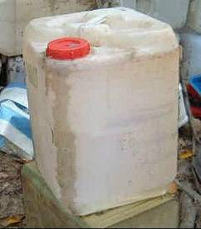

Laboratory Waste
Arbitrary disposal of laboratory waste including those of radioactivity, toxicity, corrosivity, inflammability, and infectious nature may pose a threat to health of those who work in the laboratory as well as to the environment
  Arbitrary disposal of laboratory waste is subject to lawful punishment
The collection, classification, labeling, and storage of laboratory waste and the transfer of waste to the management unit for temporary storage and final shipment for disposal should abide by the Institute’s regulations
Notes:
Complementary information:
The upper image in the slide shows a 30-L container originally designed for methanol shipment being used as a waste container in a laboratory. There were several issues with such usage:
1. The body and the cap of the container was not of a sufficient strength to withhold potential impacts when liquid waste of complicated constituents was stored. The container could be damaged by the liquid, resulting in leakage during shipment of the waste to a disposal facility.
2. As the picture shows, there were signs of liquid waste leaking around the opening. These signs suggested that spills might have occurred when the liquid was loaded into the container using a funnel.
3. There were no signs, markings, or hazardous waste symbols on the container to indicate the types of liquid waste stored in the container.

Slide 29
Section 3
Overview of Personal Protective Equipments and
Eye/Facial Protection

Slide 30

Overview of PPEs
Types of PPEs for non-emergency use
Eye and facial protection: Safety glasses and face shields
Respirators: Disposal dust masks and gas masks (for non-emergency use)
Chemical protective clothing: Lab coat and safety apron
Hand and foot protection: Gloves and safety shoes/boots
Hearing protection: Earplugs and earmuffs
……

Slide 31
Overview of PPEs
Types of PPEs for non-emergency use
PPEs can protect you only when you use them: Many PPEs were bought, displayed in the safety equipment cabinet, and never used
PPEs may bring you more harm than safety when they are improperly used: PPEs have to fit the user’s anthropometric characteristics such as the body shape, body size, and even facial characteristics in order to be protective
  The risk from being exposed to toxic substance when using PPEs may be greater than when not using PPEs, e.g., dermal absorption of chemical is typically one-to-two magnitude greater than expected when the skin is moist
31
Notes:
Key points:
PPEs can bring you more harm than safety when improperly used. Owing to its nature as “the last line of defense,” when incorrectly used the users of PPEs risk being directly exposed to the harm, suffering the consequence even more than without using the PPEs. Remember, people know they are in harm’s when they are not using PPEs, and as such they will stay alert. However, they are under a false sense of security when they have PPEs on, even if the PPEs are not functioning they way they should be.

Slide 32
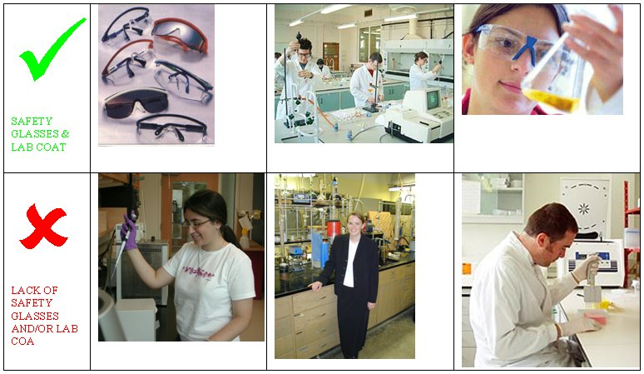
Laboratory Safety and Health Essentials…
Safety glasses and lab coat
（http://www.ecm.auckland.ac.nz/safety/safety.html）
Notes:
Key points:
1. The eyes are among the most sensitive yet vulnerable organs in human body; they can not regenerate once hurt. In the laboratory, safety glasses are needed as the eyes may be hurt or even blinded by liquid spill and airborne debris of objects.
2. The glasses that people use for vision correction do not function as the safety glasses do in protecting the eyes. Even if a person wears a pair of vision glasses, when working in the laboratory he/she still needs to put on a pair of safety glasses.
3. Wearing a lab coat in the laboratory can prevent the skin being contaminated by liquid spill or stop any harmful materials from being brought outside the laboratory (e.g., microbes and bacteria may attach to regular clothing if the clothing is worn in the laboratory without being covered by a lab coat; these microorganisms may be brought outside the laboratory and released in the ambient environment or in public places).
4. In this slide, the upper-left image shows different types of safety glasses and the upper-mid/-right images people having safety glasses and lab coat on at work. The workers in the lower-left image did not wear a lab coat and risked skin exposure to liquid chemical. In addition, the worker was wearing a pair of general glasses which was insufficient to protect against chemical spill. The person in the lower-mid picture was not engaged in experiment. However, in her case, without a lab coat when being present in the laboratory risked a contamination by the chemical or microbe there and a subsequent release of the contaminant outside the laboratory. As to the worker in the lower-right image, he was in a lab coat, but his eyes were completely uncovered and thus subject to harm if a chemical spill should occur.

Slide 33
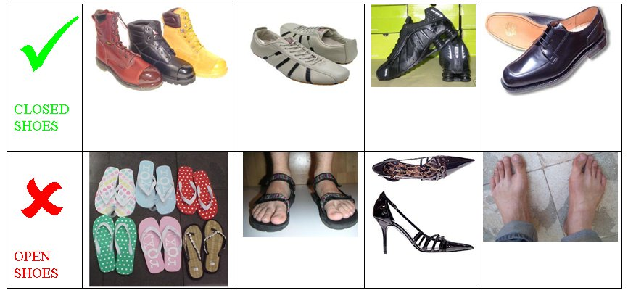
Laboratory Safety and Health Essentials…
Closed shoes
（http://www.ecm.auckland.ac.nz/safety/safety.html）
Notes:
Key points:
In the laboratory, any objects tossed in the air, including liquid spill, will eventually fall to the ground. Even if the liquid spill falls on the legs, the liquid gets to the feet eventually. Human feet are very accessible to these harms. Besides, there are harmful material and dangerous equipment of weight in the laboratory. The feet, particularly the toes, may get hurt when a person kicks on these objects by accident.
To protect the feet, the workers in the laboratory need to wear only closed shoes (as shown in the upper roll of images in the slide); never wear shoes that reveal bare feet, soles, or toes. Working in bare feet or in open shoes in the laboratory (as shown in the pictures in the lower roll) in prohibited.
In high-risk laboratories, as the conditions demand, protective shoes of high protection efficacy such as safety shoes with fronts being steel-covered or chemical protection boots may be required.

Slide 34
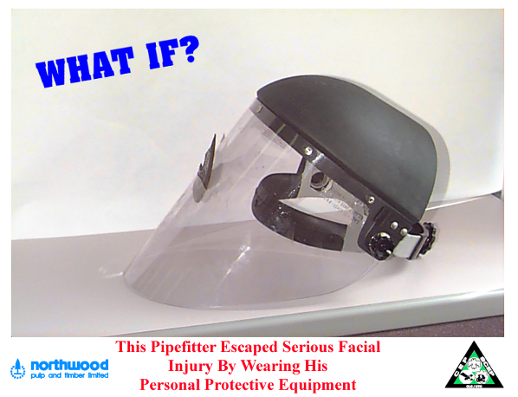
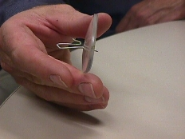
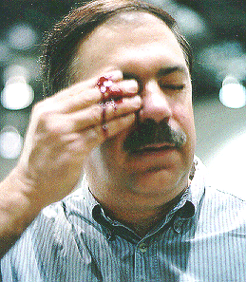
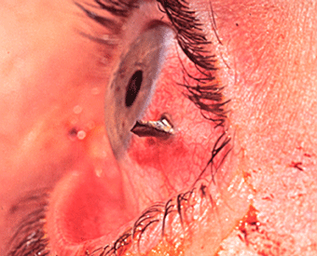
Eye and Facial Protection
If these protective gears were not in place…
The consequences would be…

Slide 35
Eye and Facial Protection
Factors prone to hurting your eyes and face in a laboratory
Hazard Type | High-Risk Task
Impact | Cutting, slicing, grinding, sculpturing, and any other tasks producing objects or debris capable of flying with sufficient momentum
Heat | Operating high-temp furnace/oven, melting/welding work, and any other tasks producing high temp
Chemical | Handling and treatment of chemical or specimen
Dust | Woodwork
Light | Welding, melting and cutting, and laser operation

Slide 36
Eye and Facial Protection
The protection offered by safety glasses
  Mechanical harms, e.g. flying objects and spilled liquid
    The shields on the side arms of safety glasses are designed to prevent entry of foreign objects
  Radiation, e.g. ultraviolet and visible light radiation
    Many facilities handling biotechnology use ultraviolet light as a tool for DNA observation; the ultraviolet light may cause damage to the cornea when a worker is continuously exposed to

Slide 37
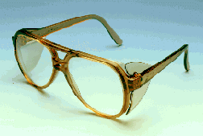
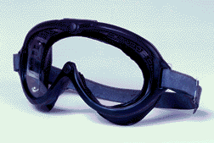
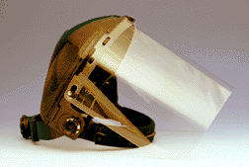
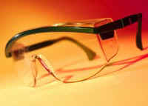
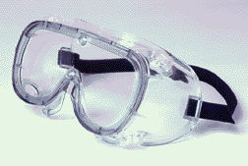
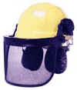
Eye and Facial Protection
Types of eye and facial protection
Safety Glasses
Goggles
Face Shields
Notes:
Key points:
Safety glasses, goggles, and face shields differ from the normal glasses used for vision correction in that the safety glasses have wings on the sides to protect against the entry of foreign objects.

Slide 38
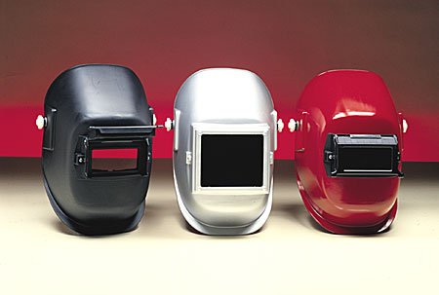

Eye and Facial Protection
Types of eye and facial protection
Welding Face Shields and Helmets
Light-Filtering Lens
Aiming to protect against light of high intensity

Slide 39
Eye and Facial Protection
Something about contact lenses
In laboratory:
  Wearing contact lenses is prohibited (as the most conservative intervention approach)
  Evaluating risk of using contact lenses is a must-do
  Using airtight goggles for additional protection if you must use contact lenses
If by accident chemical is spilled in the eyes:
  Rinsing the eyes with clean water and removing contact lenses immediately
  Continuing to rinse for at least 15-30 minutes
  Transferring the wounded to hospital

Slide 40
Eye and Facial Protection
Contact lenses are not intended for use as PPEs
Contact lenses are prohibited in the lab because:
  The reflective shutting of the eyelids when foreign objects enter makes removal of contact lenses difficult, unnecessarily delaying emergency treatment and medical attention required for the wounded
  Some chemical in the form of vapor are capable of permeating through the lenses, and interacting extensively with ocular tissues due to occlusion effect
  Long-term use of contact lenses may reduce sensitivity of cornea and secretion of tears, and thus weakening the eyes’ natural defense
Notes:
Key points:
Things to consider when evaluating appropriateness of using contact lenses in a laboratory or workplace:
(1) Type of hazard;
(2) Risk imposed on the eyes from wearing contact lenses;
(3) Risk from attempt to remove contact lenses;
(4) Presence of additional risk factors;
(5) Reduction in efficiency of protection by other protective gears due to use of contact lenses.
Reference information:
The eye and facial protection equipments should be designed to meet the following requirements:
- Not increasing discomfort when in use;
- Ease to put on and hard to break;
- Robust connection of protective elements and components to the frame;
- No sharp angles or pieces that may harm the users;
- Using replaceable components.

Slide 41
Section 4
Respirators

Slide 42
Respirators
“Dust masks”—removal of solid/liquid particulates
Filter media
Dirty air
Clean air
(Source: Organic solvent loading in canisters; Nelson, 1976)
Notes:
Key points:
The dust masks are meant to protect against liquid and solid particulates while the gas masks are protecting against gaseous and vaporized chemicals. For example, the N95 filtering-facepiece respirators can not be used to protect against gaseous contaminants.

Slide 43
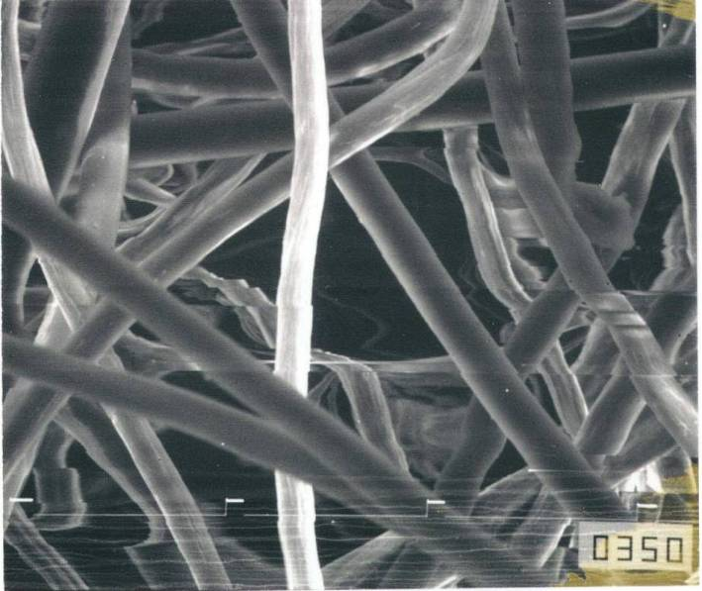
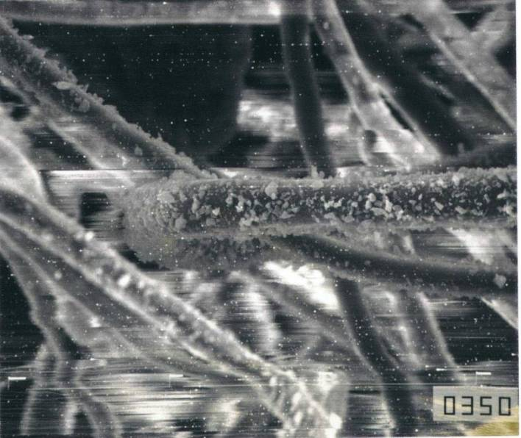
Respirators
Filtration of particulates by fibers and aging effect for mechanical filters
(Source: Air Filtration by R.C. Brown, Pergamon Press)
Clean fibers
Used fibers
43

Slide 44
Respirators
“Gas masks”—removal of gaseous/vapor contaminants
Canister with adsorbent for organic solvent
Organic solvent
Absorption curve
Organic solvent conc.
Canister depth
44
Notes:
Key points:
The diagram in this slide shows the absorption of gaseous contaminants by the activated carbon in the canister of a gas mask.

Slide 45
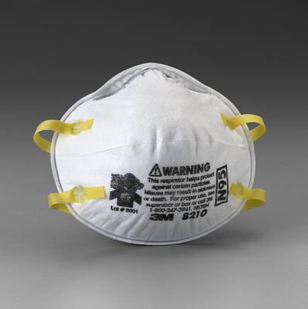
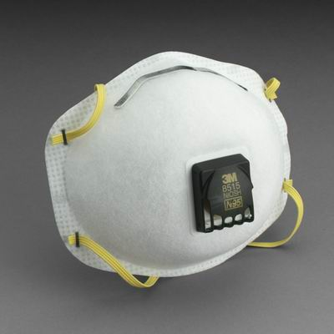
Respirators
Particulate respirators
(Filtering-facepiece respirators)
N95 half mask
N95 half mask with exhalation valve
(Source: 3M Company, USA)
45

Slide 46
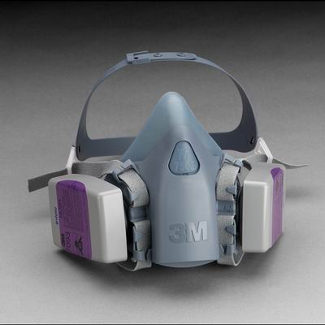
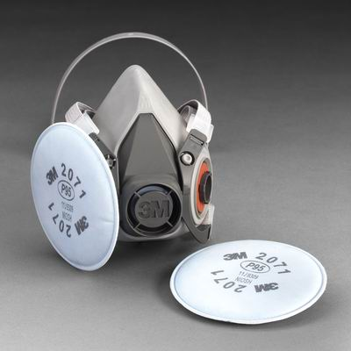
Respirators
Particulate respirators
(Filtering-facepiece respirators)
Half facepiece with P100 filter
Half facepiece with P95 filter
(Source: 3M Company, USA)
46

Slide 47

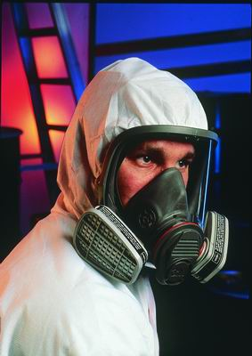
Respirators
Gas masks (Half- and full-facepiece respirators)
  Facepiece and canister/cartridge combined
  Air driven by negative pressure developed from respiration
Half-facepiece (left) and full-facepiece (right) gas mask with cartridge
(Source: 3M Company, USA)
47

Slide 48
Level of protection provided by respirators…
Surgical masks
Powered air-purifying respirators
Self-contained breathing apparatus
Filtering-facepiece respirators or half-facepiece gas masks
Full-facepiece gas masks
Air-line respirators
Emergency response use
Level of protection
48

Slide 49
Classification of particulate respirators by US National Institute for Occupational Safety and Health
Series | Level | Efficiency of Filtration (%) | Targeted Contaminants | Time of Use
N | N100 | 99.7 | Particulates and non-oil- based aerosols | Varied by use condition
 | N99 | 99
 | N95 | 95
R | R100 | 99.7 | Particulates (including oil-based aerosols) | A working day (8 hours)
 | R99 | 99
 | R95 | 95
P | P100 | 99.7 | Particulates (including oil-based aerosols) | Varied by use condition
 | P99 | 99
 | P95 | 95
49

Slide 50
Respirators
Selection of respirators
Type of respirator and level of protection required?
Not everyone can use the same type of respirator
Level of reduction in contaminant concentration by the respirator?
“Protection factor” vs. “fit factor”
50
Notes:
50
Key points:
1. When selecting a respirator, choose one that has been properly certified. A “certification” means that the specific model of respirator has been evaluated against and meet a set of criteria as required by the certifying agency. For example, the US National Institute for Occupational Safety and Health (NIOSH) provides the certification of respirators in accordance with the 42 CFR (Code of Federal Register) 84 and classifies the certified respirators into different levels of protection efficiency commonly referred to as N95, N99, P100, and etc. There are other systems of certification, including the EN (European) certification system that classifies respirators into the classes EN 149 (disposable dust masks), EN 143 (dust masks), and etc.
2. People have different facial characteristics and some have beards/scars on the face; these will affect if or not a respirator may properly fit and protect the users. Simply put, what fits you may not fit me.
3. The protection offered by a respirator is commonly determined by the protection factor and the fit factor.
Protection factor (PF): The PF is defined as the ratio of the mean concentration of the contaminant outside the facepiece to that inside. The greater the PF, the better protection the respirator may offer. The PF for different respirators in good working condition are not the same; in general full-facepiece respirators have PF greater than half-facepiece respirators do. In addition, the PF for positive-pressure respirators are typically greater than those for negative-pressure respirators.
Fit factor (FF): The FF defines if a facepiece properly fits the user and prevents the contaminant from entering the facepiece. The FF is typically determined from a quantitative fit test, and is formulated as the ratio of the contaminant concentration in the air to that inside the facepiece. For example, if the contaminant concentration outside the facepiece is 300 ppm and that inside is 3 ppm, then the FF for the tested user is 100.

Slide 51
Respirators
Presence of airborne hazard: A result of air being unsafe to breath (e.g. insufficient oxygen content) or being contaminated by a hazardous material
Understanding IDLH (Immediately Dangerous to Life or Health concentration)—only air-supplying respirators may be used under IDLH condition
IDLH is a threshold concentration developed to prevent acute toxicity arising from inhalational exposure to hazardous material; when exposed to a target chemical at concentration beyond IDLH a person may suffer: 1) death; 2) irreversible health effect; or 3) loss of ability to escape
Notes:
Key points:
1. Before making a decision on using a respirator, the workplace management and the worker need to confirm the presence of an inhalational hazard in the workplace, specifically, the type of hazard involved, e.g., oxygen deficiency, dust, toxic gas/vapor, presence of chemical immediately dangerous to life or health, and etc.
2. Respirators are always required when the concentration of the target chemical in the air reaches the IDLH (Immediately Dangerous to Life or Health concentration), as once the concentration exceeds the IDLH the person exposed to the chemical may be: 1) losing life; 2) suffering irreversible health consequence; or 3) losing the ability to escape. Only air-supplying respirators should be used under IDLH conditions, e.g., the self-contained breathing apparatus (SCBA) used by firefighters or emergency responders.

Slide 52
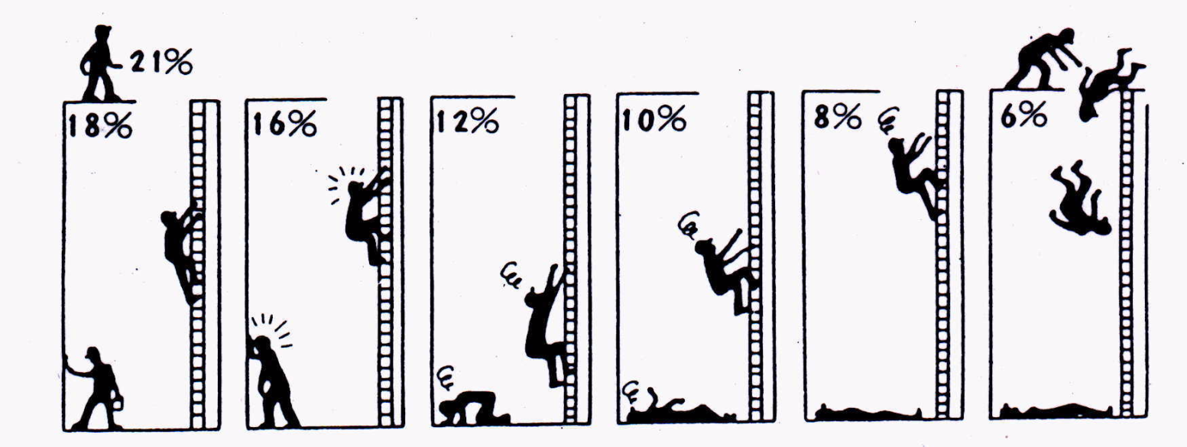
Respirators
Oxygen content and physiological response
Safe but continuous ventilation required
Increase in respiration and pulse rate; headache; nausea
Dizziness; nausea; weakness in muscle strength resulting in falling
Paleness; unconscious-ness
Unconscious-ness and faint; death in 7-8 mins
Instan-taneous faint; stop of breathing; spasm; death in 6 mins

Slide 53
Protection Factor (PF)
Avg. conc. of contaminant in air
PF =
Avg. conc. of contaminant inside respirator
PF = FF (fit factor) when filtration efficiency reaching 100%
Filter efficiency + Facepiece leakage
Filter efficiency testing
☞ 42 CFR Part 84
☞ EN 149:2001
☞ CNS 14755 Z2125
Fit testing
Notes:
Key points:
This slide shows how to calculate the protection factor and the significance of each component involved in the calculation.
The protection factor is defined as the ratio of the contaminant’s concentration in the air to that inside the respirator. The higher the protection factor, the greater the level of protection the respirator may offer. Different models of respirators have different protection factors. In general, the factors for full-facepiece respirators are higher than half-facepiece ones; so are the factors for positive-pressure respirators than those for negative-pressure ones.

Slide 54
Fit Factor (PF)
Fit of facepiece varies by model as well as by user…
 | Surgical mask 1 | Surgical mask 2 | Surgical mask 3 | N95 mask 1 | N95 mask 2
Mean | 3.9 | 5.7 | 4.0 | 21.6 | 80.9
Std. Dev. | 2.1 | 4.4 | 3.0 | 27.7 | 70.7
Maximum | 8.4 | 23.3 | 17.0 | 112.6 | 200.0
Minimum | 1.2 | 2.0 | 1.4 | 1.6 | 4.4
FF > 100 | 0.0% | 0.0% | 0.0% | 6.5% | 35.5%
What fits you may not fit me
Notes:
Key points:
This slide demonstrate the fit factors for different models of respirators as determined from fit testing. Surgical masks 1, 2, and 3 are so called “flat masks.” They are not considered respirators in industrial hygiene, as they can not effectively reduce the concentration of particles present in the air when the particles move across the filters inside the mask. Frequently the flat masks have near-zero fit factors.
In comparison, the two masks to the right of the table are N95 filtering-facepiece respirators. They have greater fit factors compared to those of the surgical masks, and they can much better reduce the concentration of the particles in the air stream moving across the mask. However, even both classified as a N95 class, these two masks have distinctly different fitting characteristics. It is also important to know that the fit factor varies among people even when they are using the same respirator. For example, for N95 mask 2 the highest fit factor can reach 200 whereas the lowest level is only a single-digit number.

Slide 55
Respirators
Proper use of respirators
Select a correct and effectively working respirator
Perform fit check before use
Fit test (qualitative and quantitative) vs. fit check (positive pressure and negative pressure)
Notes:
Key points:
The previous slide demonstrates the importance of selecting a respirator that fits the user’s facial characteristics and the significance of using the respirator in a correct manner. This slide introduces the matters to attend to when using a respirator, including the fit check and fit test.

Slide 56
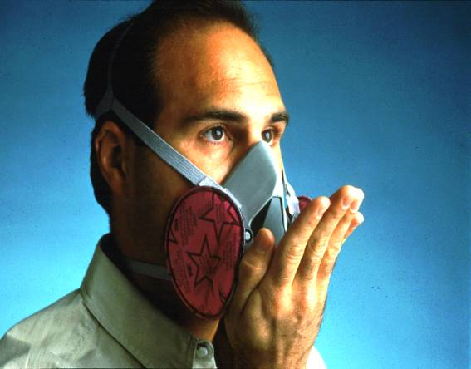
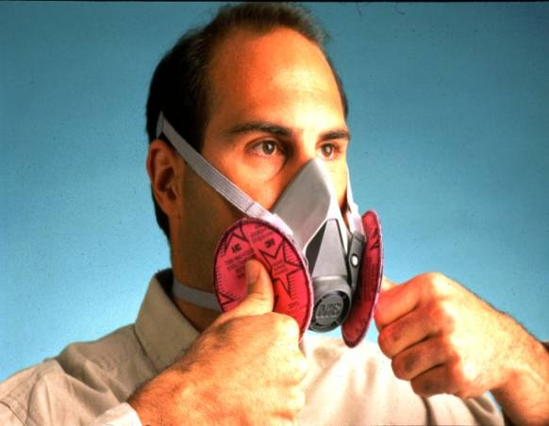
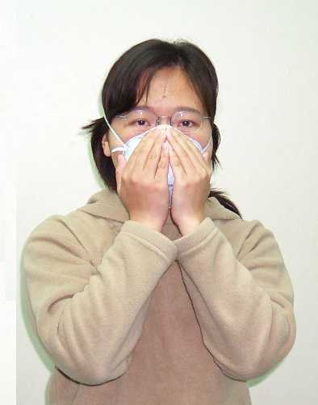
Respirators
Fit check ensures fit of respirator and should be performed every time you put a respirator on
Demonstrated below are proper ways to perform fit check
Positive-pressure fit check
Negative-pressure fit check
Simplified fit check for disposable mask

Slide 57
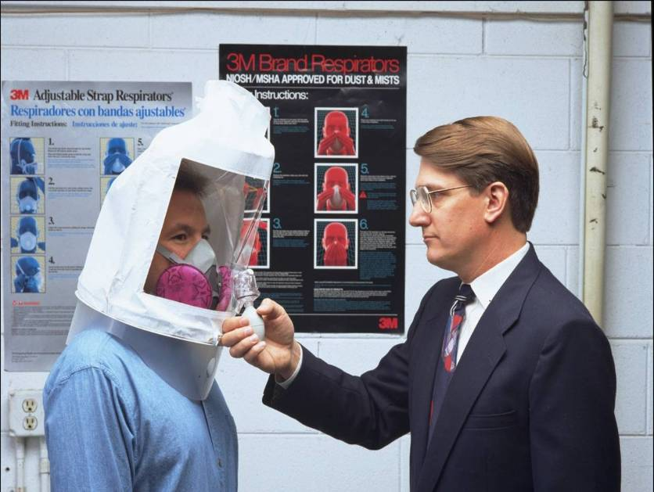
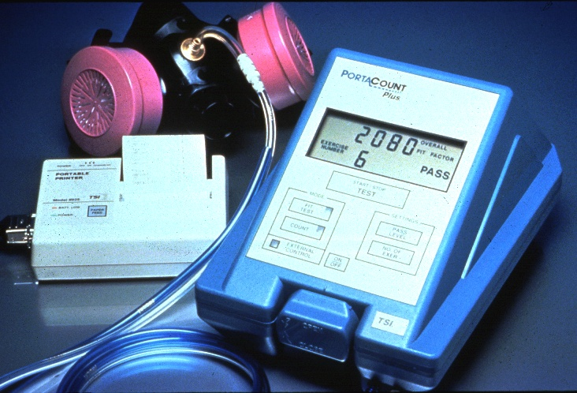
Respirators
Fit test ensures fitting of a selected model to the user’s facial characteristics and should be performed when a new respirator is selected and also on a routine basis
Qualitative fit test
  Dust masks: Using saccharin or Bitrex solution
  Gas masks: Using banana oil
Quantitative fit test
  Measuring concentrations present inside and outside of facepiece
Notes:
Key points:
The qualitative fit test employs a chemical agent as the testing solution. If the respirator user smells or tastes the agent, then the test fails. When testing a dust mask, the chemical agent used is typically saccharin or Bitrex; when testing a gas mask the agent is frequently banana oil. In contrast, the quantitative fit test measures and compares the concentrations of the agent inside and outside the mask, thus do not rely on the subjective sensation of the respirator user.

Slide 58
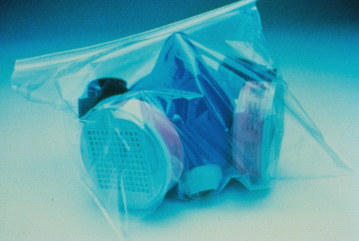
Respirators
Storage of respirators
  Respirators should be prevented from
  Physical damage
  Chemical contact
  Dust contact
  Sunlight exposure
  Extreme temperature
  Excessive moisture
  Respirators for emergency use should be clearly labeled with user instructions and stored in adequate, accessible places
Notes:
Key points:
- Respirators should be properly stored when not in use, otherwise they may gradually deteriorate over time;
- Respirators for emergency use should be so labeled, clearly, with instructions on how to use.

Slide 59
Section 5
Chemical Protective Clothing and Hand Protection

Slide 60
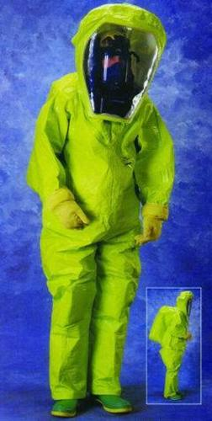


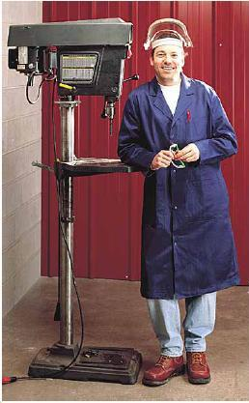
Chemical Protective Clothing in Common Use…
Level A Ensemble
Airtight clothing
Self-contained breathing apparatus (SCBA) or air-line respirator
Level B
Non-airtight clothing, gloves, boots
SCBA or air-line respirator
Level C
Clothing, gloves, boots
Half-/full-facepiece respirator
Level D
Boots
No respirator required
60

Slide 61
Protective Clothing
Laboratory coat
Lab coat are required when staying in laboratory handling or storing chemical
Lab coat should be removed immediately if contaminated; white coat are preferred, and should be kept clean
Long pants and closed shoes of low heel are the preferred personal clothing; baggy clothes and long hairs are prone to accidents in a laboratory
Notes:
Key points:
Wearing a lab coat is required in laboratory handling or storing chemical. The coat is usually white, as the color facilitates a quick and easy identification of accidental spill should it occur. The cover-all design of the lab coat allows quick removal when the coat is contaminated. Keep in mind that the lab coat is the first line of defense when chemical spill occurs and it provides a barrier to skin contamination. Replace or repair the lab coat immediately if it is torn or worn.
In certain occasions the protective clothing may be task-specific. For examples, chemical protective clothing sufficient to isolating the worker from chemical contact should be worn when handling chemical of significant toxicity or corrosivity, and protective clothing sufficient to preventing contact of the worker with specimen or microbiological samples should be worn when handling these types of samples.

Slide 62

Selection of chemical protective clothing…
(Source: Forsberg and Mansdorf, 2004)
62

Slide 63
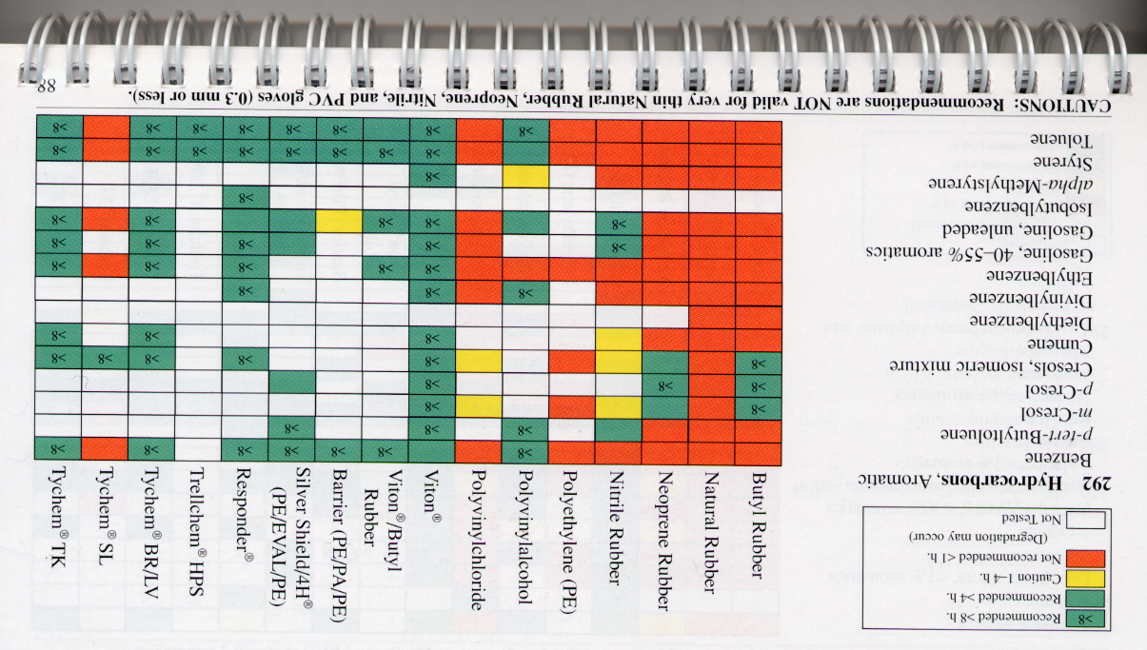
Color-Coded Recommendations
“Green” indicates “recommended > 4 h or > 8 h”
63

Slide 64

Hand Protection
Death of Dr. Wetterhahn—absorption of dimethylmercury following its permeation through latex gloves
There is no glove material that can completely stop permeation of all chemicals; the difference lies in how long it takes for chemical to break through
(Exposure of skin to hydro-fluoric acid. Source: Taiwan Institute of Occupational Safety and Health)
Notes:
Key points:
The story about Dr. Wetterhahn:
Dr. Karen Wetterhahn was a Professor of Chemistry at the Dartmouth College, New Hampshire, USA. Her research interest included heavy metals. In 1997, Dr. Wetterhahn used latex gloves provided by the school when conducting experiments on dimethylmercury, and was diagnosed in January, 1997, of mercury poisoning. She was hospitalized after 3 weeks, but deceased in June that year. The school initiated an investigation on Dr. Wetterhahn’s accident and concluded, as supported by the statement previously prepared by the late Dr. Wetterhahn, the misuse of protective gloves as the cause of this tragedy. Dimethylmercury was capable of permeating through the latex gloves and the skin and caused poisoning. The US National Institute for Occupational Safety and Health cautioned the permeation of dimethylmercury through the latex gloves in a number of guidance documents, and the box containing the gloves used in Dr. Wetterhahn’s laboratory also clearly showed warnings on using latex gloves for protection against chemical penetration. Following the investigation, the school presented the case to the Chemical and Engineering News published by the American Chemical Society to remind those who were engaged in laboratory on similar topics of research. The US Occupational Safety and Health Administration (OSHA) charged the Dartmouth College with negligence as: (1) the laboratory safety plan was insufficient, particularly regarding the selection and use limitations of protective gloves; and (2) the school did not provide education and training on the use of protective gloves. The Dartmouth College was fined USD 9,000 by the OSHA. The school subsequently took corrective actions that included: (1) increasing the number of training courses for the selection and use of protective gloves; (2) hiring chemical safety specialists; and (3) organizing a chemical safety committee to promote chemical safety on campus.

Slide 65
Hand Protection
Gloves commonly used in laboratory
  Gloves made of cottons and asbestos for protection against heat and sometimes covered in alumina for protection against chemical and water
  Plastic gloves made from mold-dipping for protection in tasks handling chemical or oil/grease
  Gloves made of leather for protection in welding works
  Gloves supported by metal net to prevent finger-cutting when handling knifes or sharp objects
65
Notes:
65

Slide 66






Gloves in Common Use
Natural rubber
Neoprene rubber
Nitrile rubber
Polyvinyl chloride
Polyvinyl alcohol
Butyl rubber
66
Notes:
Key points:
The chemical protective gloves shown in this slide are those of common use in the. In fact, most chemical protective gloves availability on the market are made of polymeric materials such as natural rubber, nitrile, neoprene, butyl rubber, polyvinyl chloride, polyvinyl alcohol, polyurethane and etc.

Slide 67
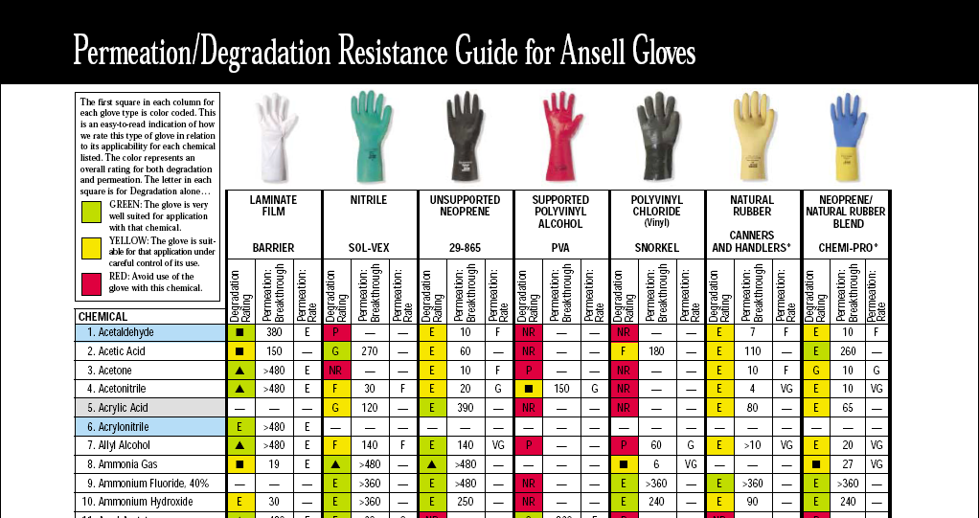
Rating of gloves for permeation and degradation resistance
(Source: Ansell Occupational Healthcare 2003)
67
Notes:
Key points:
1. Two technical indicators are typically considered when evaluating the effectiveness of the gloves protecting against chemical permeation, the steady-state permeation rate and the breakthrough time. The permeation rate, expressed in µg/cm²/min, indicates the mass of a chemical moving across a unit surface area of the barrier material used in constructing the gloves during a unit period of time; whereas the breakthrough time shows the time it requires for the chemical coming in contact with a glove from the outside to move across the membrane and appear on the inside of the glove at a concentration above the detection limit.
2. Keep in mind that there is no universal glove material that may resist the permeation of all chemicals; the protective efficiency of the gloves lies in how long the barrier can resist the chemical from appearing inside the gloves at a significant level (i.e. how long the time it takes for the chemical to break through).

Slide 68
Hand Protection
Indices applied in selection of gloves
Chemical to handle
Duration of exposure
☑ Material in gloves
☑ Dexterity and thickness
☑ Comfort
☑ Temperature at work
☑ Anti-aging characteristics
☑ Permeation rate
☑ Mechanical strength
☑ Level of voltage encountered
☑ Work process
☑ Certification of glove inspection
☑ Manufacturer
☑ Cost

Slide 69
Hand Protection
Cautions on using gloves
  The barrier material used in constructing the gloves should not allow for skin absorption of chemical or become a source of dermatoses
  If you use barrier creams, keep in mind they do not offer a complete resistance to chemical permeation
  When operating a machine, take the gloves off before you work; the gloves may be tangled and rolled into the operating or moving machine
  Do not mix-use different gloves
  The protective gloves should fit the user’s hands and not interfere with capability holding objects
69
Notes:
69

Slide 70
Hand Protection
Inspection
The status of protective gloves must be checked before they are used
☑ Any change in color?
☑ Any puncture or sign of tearing?
☑ If defect is suspected, change the gloves
Notes:
Key points:
Protective gloves are subject to manufacturing defects, and the users should check for these potential defects when using them. Specifically, checking for puncture holes and signs of tearing on the gloves. In addition, the users should check the expiration date of the gloves and refer to the breakthrough time of the chemical the gloves are supposed to protect against. Replace the gloves before they expire or deteriorate.

Slide 71
Hand Protection
Usage and limitations
Proper donning and doffing of gloves
Proper use of disposal vs. non-disposal gloves
Wash hands immediately once gloves are removed
Gloves are not to be used in tasks where drills and cutting tools are involved and finger-cutting is a risk
Review Safety Data Sheet when organic solvent is used in task so to determine efficacy of barrier material
Notes:
Key points:
Warnings on using safety gloves:
1. Gloves are not to be used in tasks where drills and cutting tools are involved and finger-cutting is a risk;
2. Gloves should be checked on their appearance before and after each use;
3. There are no universal gloves in terms of protection efficacy; to properly protect, the gloves should be selected based on the task demands;
4. Some gloves are resistant to concentrated sulfuric acid but not to dilute sulfuric acid;
5. The gloves resistant to permeation of individual solvents may not be equally resistant to the mixture of these solvents;
6. Plasticizers and fasteners are frequently used in glove manufacturing; they are different from the polymers in the gloves constituting the main barrier, and their release due to the breakdown of the gloves should be considered when selecting gloves;
7. Rubber gloves capable of protecting against electricity should be used when working in the task where voltage is involved;
8. Leather gloves should be used to cover the rubber-made, high voltage-resisting gloves (Class B or C) so to protect the rubber gloves from puncture or tearing from work;
9. The watch or bracelet should be removed prior to wearing the voltage-resisting gloves;
10. After putting on the gloves pinch the fingers and see if it hurts; check the seams of the gloves on the finger parts to make sure that they are well aligned;
11. When using the gloves designed to protect against vibration, be cautious on how you hold an equipment or tool. Strong vibration is typically felt when the equipment is held tightly. However, the equipment may quickly turn loose when held lightly;
12. Replace the gloves if any defects are found in inspection or in use; discard the defected products.
Proper maintenance of safety gloves:
1. Do not store the gloves in place of high temperature and/or high humidity;
2. Some glove material may deteriorate when coming in direct contact with the air; store them using plastic bags;
3. Leather gloves for use in welding works can not be water-washed; they should not be sealed in plastic bags as they are subject to mold growth and attachment when placed and sealed for a long time in the bag;
4. Do not put heavy objects over the gloves or attempt to fold the gloves when preparing them for storage;
5. Wash the electricity-resisting gloves contaminated by oil or grease with alcohol; if washed by water, dry the gloves immediately using dry cloth, and then air-dry them in a shadowed area;
6. Do not wash the electricity-resisting gloves with solvent of high lipophilicity;
7. Do not expose the electricity-resisting gloves to direct sunshine (deterioration due to exposure to ultraviolet light may occur); cover the gloves with talcum powder when storing them in a box at room temperature to prevent deformation;
8. Chemical protective gloves used in industrial hygiene are typically water-washed after use (except for the gloves made of polyvinyl alcohols) and then air-dried in a shadowed area;
9. Follow the manufacturer’s instructions on glove maintenance and storage.

Slide 72




Hand Protection
Steps to remove disposal gloves
1.
3.
2.
4.
Notes:
Key points:
1. Use one hand to pull out the glove near the wrist of the other hand, and then move the glove in the direction toward the fingers for doffing.
2. Keep the removed glove in the hand that still has the glove on, and then slide the fingers of the bare hand into the glove remaining on the hand through the opening near the wrist. Gradually pull off the glove.
3. The second glove will be inside out at this stage, with the first glove wrapped in. Properly dispose of these gloves.
4. Wash the hands every single time after glove-doffing.

Slide 73
Acknowledgements
This slideshow was compiled and edited by Chen-Peng Chen of Department of Occupational Safety and Health (DOSH), China Medical University (CMU), based on the information originally presented in the following teaching materials:
  “Management of Laboratory Safety and Health” and “Personal Protective Equipments”, Examination Center for Laboratory Safety and Health, National Taiwan University (2011)
  “Industrial Toxicology” and “Personal Protective Equipments”, Chen-Peng Chen, DOSH, CMU (2015)

